Slide 1

Stock Price Prediction
Guide
N D S S KIRAN RELANGI, Assistant Professor, CSE
Contributors
Somaraju Dinesh 317126510170
Adduri Maruthi Siva Rama Raju 318126510L25
Sasumana Rahul 317126510167
Oruganti Naga Sandeep 318126510L29

Slide 2
Introduction
Time Series forecasting & modelling plays an important role in data analysis. Time series analysis is a specialized branch of statistics used extensively in fields such as Econometrics & Operation Research. Time Series is being widely used in analytics & data science.
Stock prices are volatile in nature and price depends on various factors. The main aim of this project is to predict stock prices using Long Short Term Memory (LSTM) with Least mean squares (LMS) Algorithm.

Slide 3
Literature Survey
1) Study on the prediction of stock price based on the associated network model of LSTM
The prediction methods can be roughly divided into two categories, statistical methods and artificial intelligence methods. Statistical methods include logistic regression model, ARCH model, etc. Artificial intelligence methods include multi-layer perceptron, convolutional neural network, naive Bayes network, back propagation network, single-layer LSTM, support vector machine, recurrent neural network, etc. They used Long short-term memory network (LSTM).
Long short‑term memory network:
Long short-term memory network (LSTM) is a particular form of recurrent neural network (RNN).
Working of LSTM:
LSTM is a special network structure with three “gate” structures. Three gates are placed in an LSTM unit, called input gate, forgetting gate and output gate. While information enters the LSTM’s network, it can be selected by rules. Only the information conforms to the algorithm will be left, and the information that does not conform will be forgotten through the forgetting gate.
The experimental data in this paper are the actual historical data downloaded from the Internet. Three data sets were used in the experiments. It is needed to find an optimization algorithm that requires less resources and has faster convergence speed.

Slide 4
Literature Survey
2) An innovative neural network approach for stock market prediction
An innovative neural network approach for stock market prediction Xiongwen Pang1 · Yanqiang Zhou1 · Pan Wang1 · Weiwei Lin2 · Victor Chang3
Used Long Short-term Memory (LSTM) with embedded layer and the LSTM neural network with automatic encoder.
LSTM is used instead of RNN to avoid exploding and vanishing gradients.
In this project python is used to train the model, MATLAB is used to reduce dimensions of the input. MySQL is used as a dataset to store and retrieve data.
The historical stock data table contains the information of opening price, the highest price, lowest price, closing price, transaction date, volume and so on.
The accuracy of this LSTM model used in this project is 57%.

Slide 5
Literature Survey
3) Stock Market Prediction Using Machine Learning
The research work done by V Kranthi Sai Reddy Student, ECM, Sreenidhi Institute of Science and Technology, Hyderabad, India. In the finance world stock trading is one of the most important activities. Stock market prediction is an act of trying to determine the future value of a stock other financial instrument traded on a financial exchange. This paper explains the prediction of a stock using Machine Learning. The technical and fundamental or the time series analysis is used by the most of the stockbrokers while making the stock predictions.
The programming language is used to predict the stock market using machine learning is Python. In this paper we propose a Machine Learning (ML) approach that will be trained from the available stocks data and gain intelligence and then uses the acquired knowledge for an accurate prediction. In this context this study uses a machine learning technique called Support Vector Machine (SVM) to predict stock prices for the large and small capitalizations and in the three different markets, employing prices with both daily and up-to-the-minute frequencies.

Slide 6
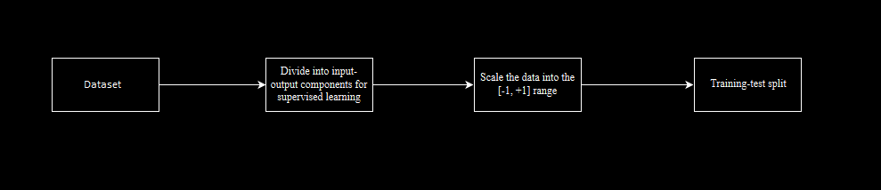
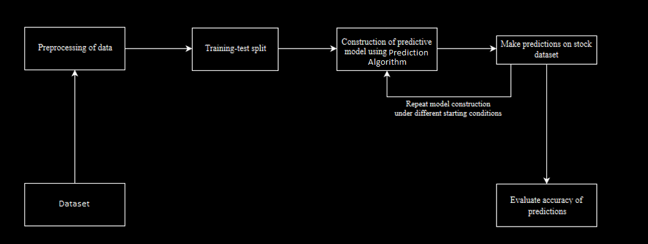
System Architecture
1) Preprocessing of data:
2) Overall Architecture:

Slide 7




Importing Datasets

Slide 8
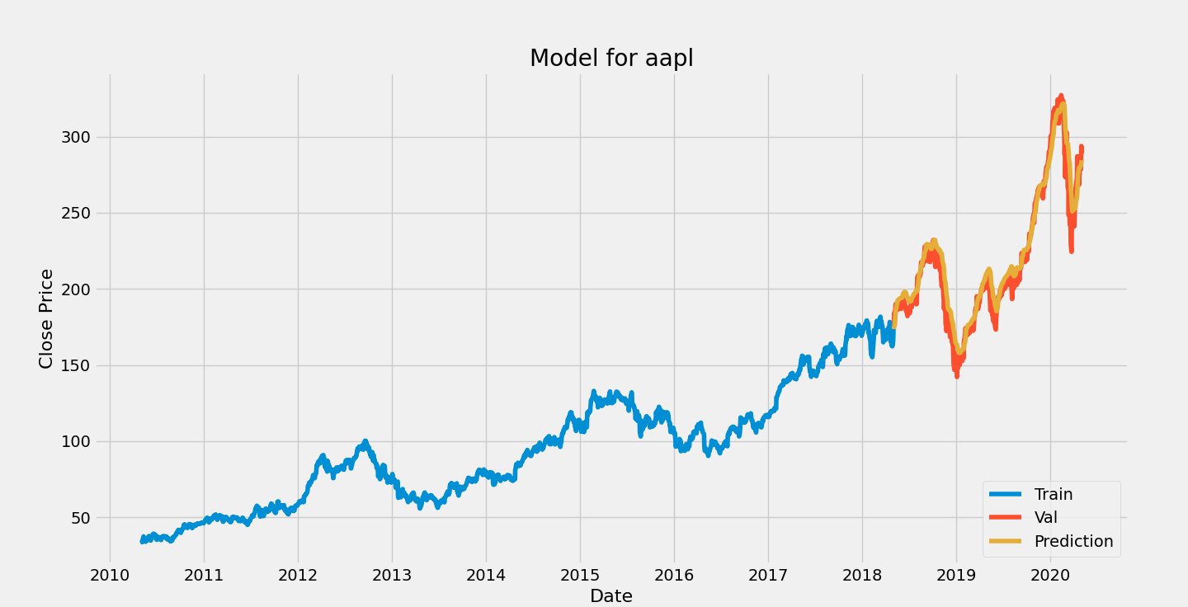
Modules
Preprocessing
Normalization
LMS Algorithm
LSTM Algorithm
Error Calculation

Slide 9
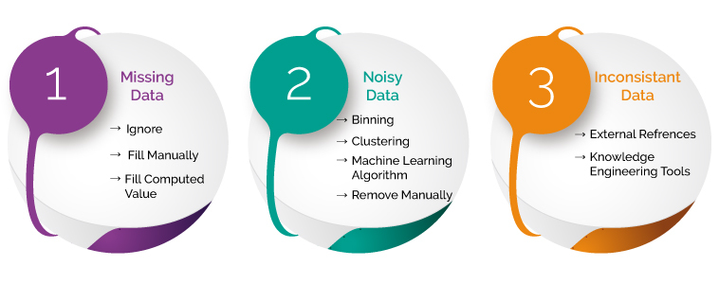
Preprocessing
In any Machine Learning process, Data Preprocessing is that step in which the data gets transformed, or Encoded, to bring it to such a state that now the machine can easily parse it. In other words, the features of the data can now be easily interpreted by the algorithm.
In our datasets we have removed unnecessary columns like Date, Time, etc. for processing.

Slide 10
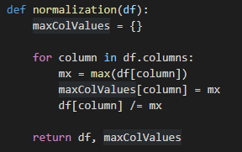
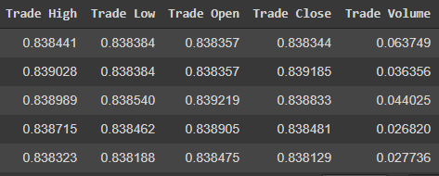
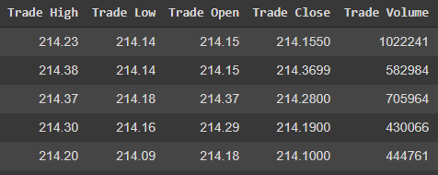
Normalization
Normalization is applied to change the values of numeric columns in the dataset to use a common scale, without distorting differences in the ranges of values or losing information
we are using Max value in column to divide the whole column to get the values in range [0, 1]

Slide 11
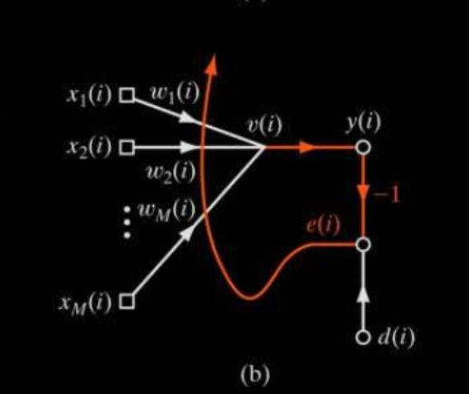
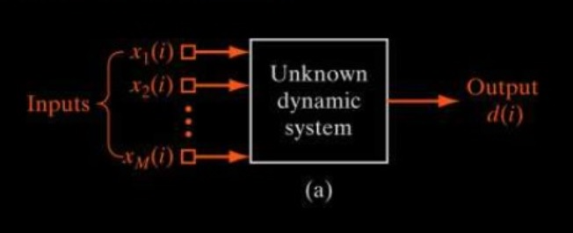
Least Mean Square (LMS) Algorithm
Linear adaptive filtering algorithm (inspired by the perceptron).
Used for solving problems such as prediction.
Linear computational complexity with respect to adjustable parameters.
Robust with respect to external disturbance.
Simple to code.

Slide 12
Filtering Structure of LMS Algorithm
Adaptive filtering (system identification):
Start from an arbitrary setting of the adjustable weights.
Adjustment of weights are made on continuous basis.
Computation of adjustments to the weight are completed inside one interval that is one sampling period long.
Adaptive filter consists of two continuous processes:
Filtering process: computation of the output signal y(i) and the error signal e(i).
Adaptive process: The automatic adjustment of the weights according to the error signal.

Slide 13
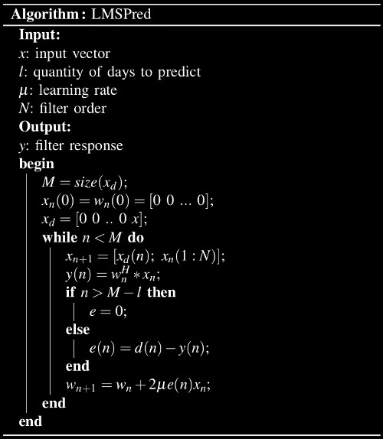
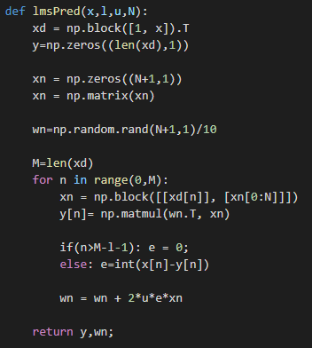
LMS Algorithm
Algorithm
Code

Slide 14
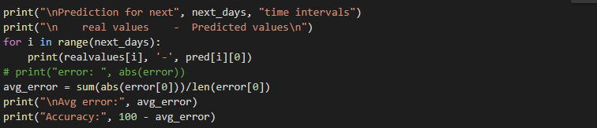
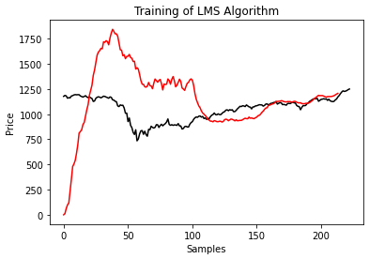
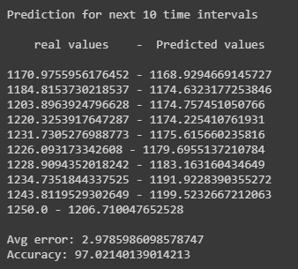
LMS Algorithm Outputs

Slide 15
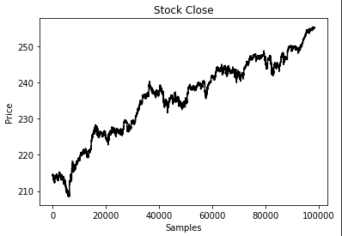
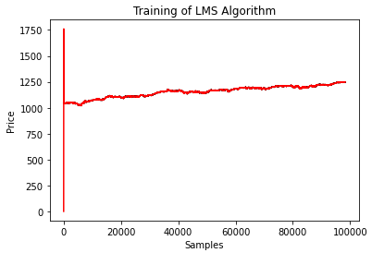
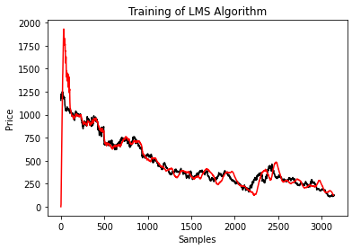
LMS Algorithm Outputs
Tw_spy_data
Accuracy: 99.95 %
Google Dataset
Accuracy: 89.89 %
Nifty50 Dataset
Accuracy: 97.02 %

Slide 16

LSTM Architecture

Slide 17
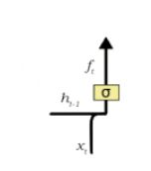
LSTM
Forget Gate:
A forget gate is responsible for removing information from the cell state.
The information that is no longer required for the LSTM to understand things or the information that is of less importance is removed via multiplication of a filter.
This is required for optimizing the performance of the LSTM network.
This gate takes in two inputs; h_t-1 and x_t. h_t-1 is the hidden state from the previous cell or the output of the previous cell and x_t is the input at that particular time step.

Slide 18
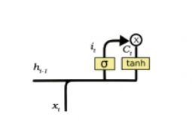
LSTM
Input Gate:
Regulating what values need to be added to the cell state by involving a sigmoid function. This is basically very similar to the forget gate and acts as a filter for all the information from hi-1 and x_t.
Creating a vector containing all possible values that can be added (as perceived from h_t-1 and x_t) to the cell state. This is done using the tanh function, which outputs values from -1 to +1.
Multiplying the value of the regulatory filter (the sigmoid gate) to the created vector (the tanh function) and then adding this useful information to the cell state via addition operation.

Slide 19
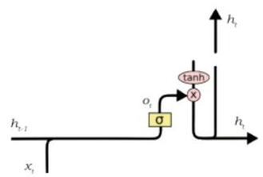
LSTM
Output Gate:
The functioning of an output gate can again be broken down to three steps:
Creating a vector after applying tanh function to the cell state, thereby scaling the values to the range -1 to +1.
Making a filter using the values of h_t-1 and x_t, such that it can regulate the values that need to be output from the vector created above. This filter again employs a sigmoid function.
Multiplying the value of this regulatory filter to the vector created in step 1, and sending it out as a output and also to the hidden state of the next cell.

Slide 20
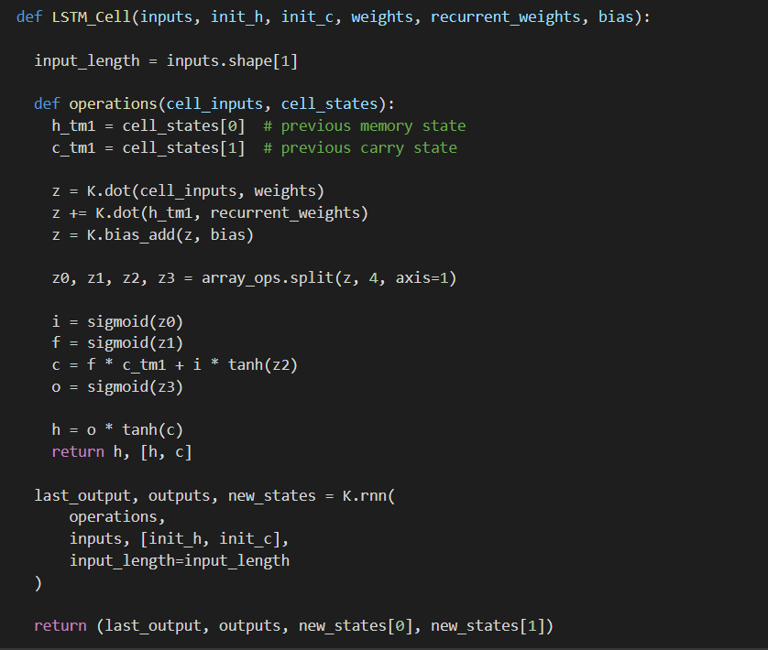
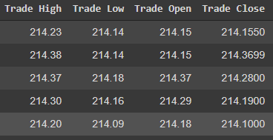
LSTM Algorithm

Slide 21
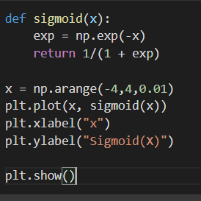
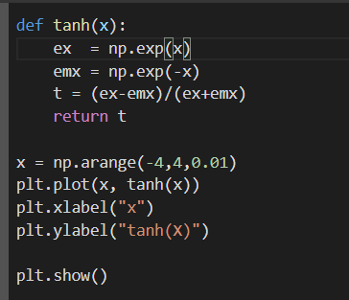
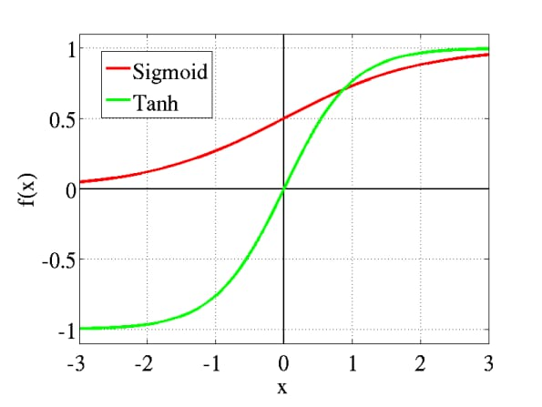
Sigmoid and tanh functions

Slide 22
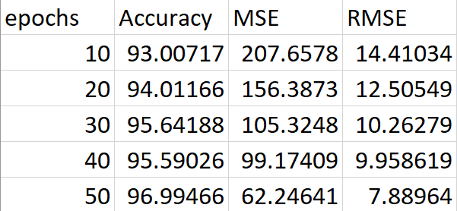
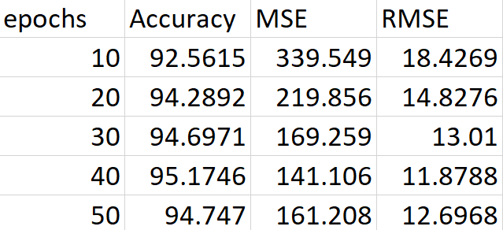
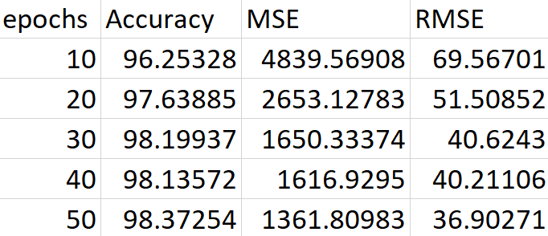
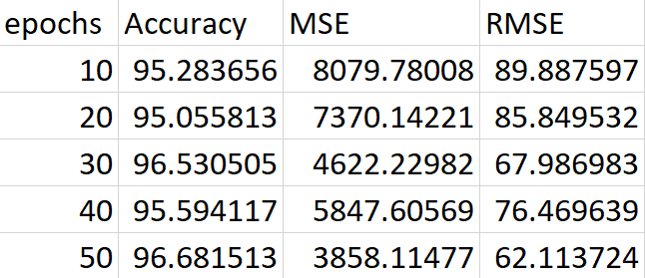
Comparison of LSTM and LSTM with LMS
LSTM LSTM with LMS
Google Dataset:
Reliance Dataset:

Slide 23

Homepage

Slide 24
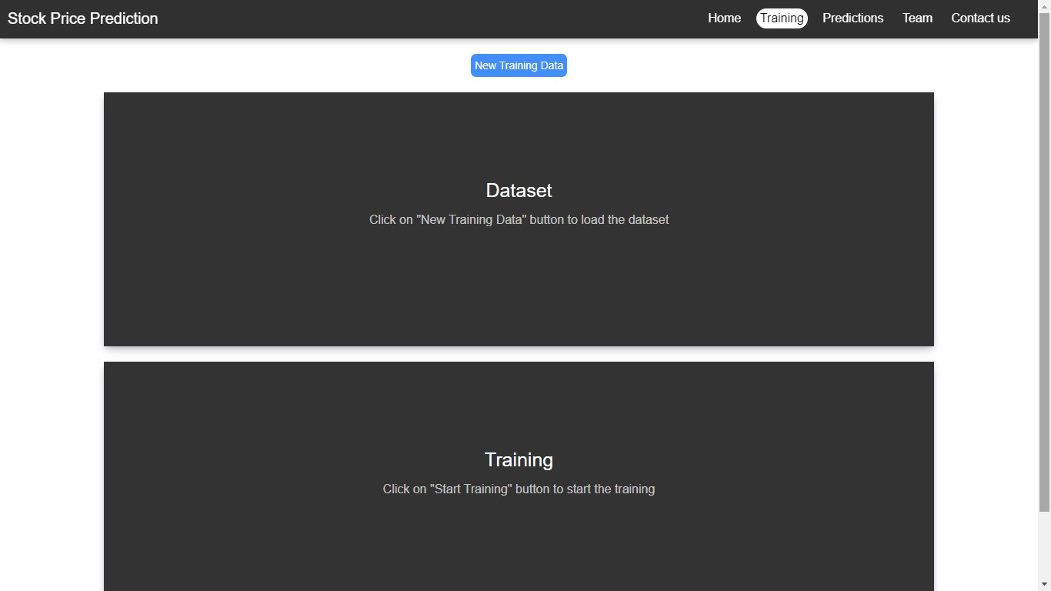
Training

Slide 25
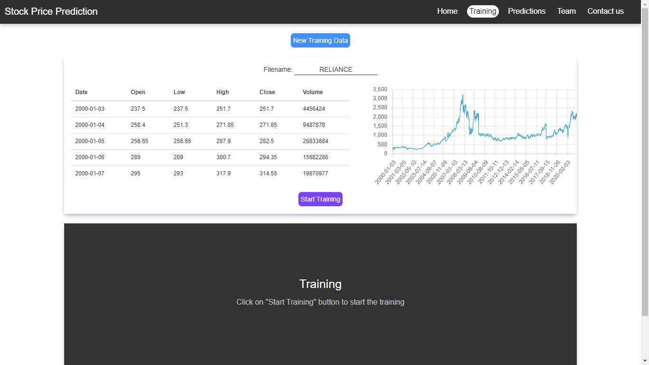
Training – While Training

Slide 26
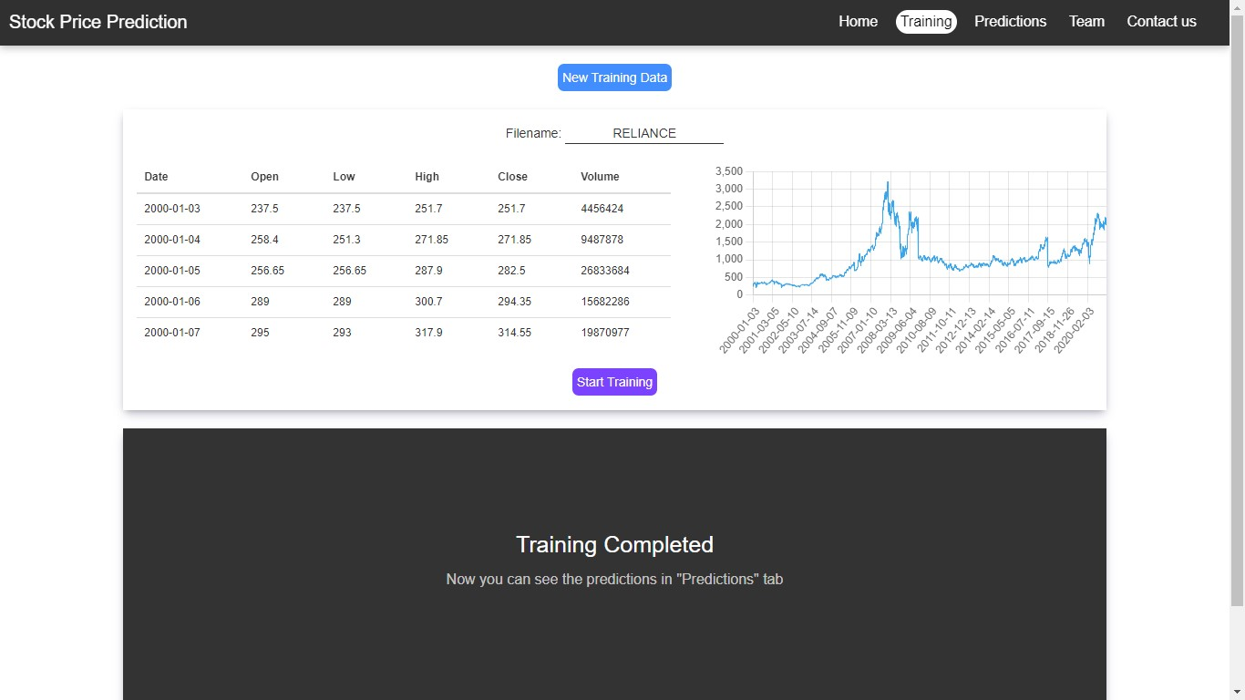
Training – Training Completed

Slide 27
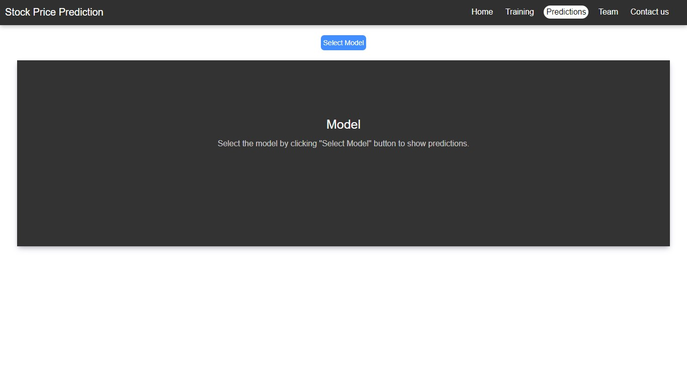
Predictions

Slide 28
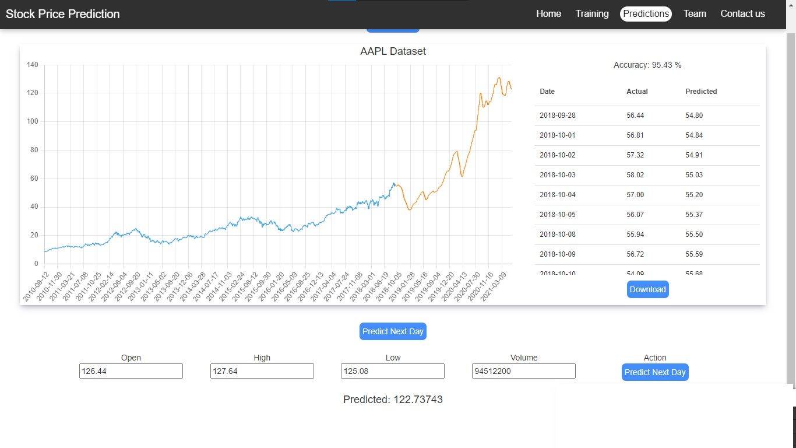
Predictions – After selecting the model

Slide 29
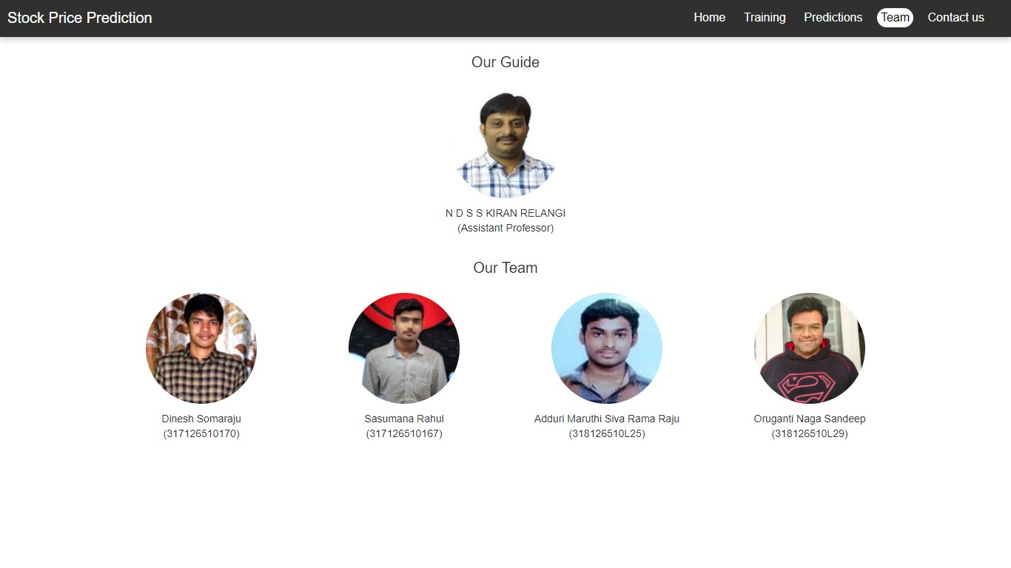
Team

Slide 30
Conclusion
In this project, we are predicting closing stock price of any given organization, we developed a web application for predicting close stock price using LMS and LSTM algorithms for prediction. We have applied datasets belonging to Google, Nifty50, TCS, Infosys and Reliance Stocks and achieved above 95% accuracy for these datasets.

Slide 31
Future work
We want to extend this application for predicting cryptocurrency trading.
We want to add sentiment analysis for better analysis.

Slide 32
References
Stock Price Prediction Using LSTM on Indian Share Market by Achyut Ghosh, Soumik Bose1, Giridhar Maji, Narayan C. Debnath, Soumya Sen
S. Selvin, R. Vinayakumar, E. A. Gopalkrishnan, V. K. Menon and K. P. Soman, "Stock price prediction using LSTM, RNN and CNN-sliding window model," in International Conference on Advances in Computing, Communications and Informatics, 2017.
Murtaza Roondiwala, Harshal Patel, Shraddha Varma, “Predicting Stock Prices Using LSTM” in Undergraduate Engineering Students, Department of Information Technology, Mumbai University, 2015.
Xiongwen Pang, Yanqiang Zhou, Pan Wang, Weiwei Lin, “An innovative neural network approach for stock market prediction”, 2018
Ishita Parmar, Navanshu Agarwal, Sheirsh Saxena, Ridam Arora, Shikhin Gupta, Himanshu Dhiman, Lokesh Chouhan Department of Computer Science and Engineering National Institute of Technology, Hamirpur – 177005, INDIA - Stock Market Prediction Using Machine Learning.
Pranav Bhat Electronics and Telecommunication Department, Maharashtra Institute of Technology, Pune. Savitribai Phule Pune University - A Machine Learning Model for Stock Market Prediction.
Anurag Sinha Department of computer science, Student, Amity University Jharkhand Ranchi, Jharkhand (India), 834001 - Stock Market Prediction Using Machine Learning.
V Kranthi Sai Reddy Student, ECM, Sreenidhi Institute of Science and Technology, Hyderabad, India - Stock Market Prediction Using Machine Learning.
Asset Durmagambetov currently works at the mathematics, CNTFI. Asset does research in Theory of Computation and Computing in the fields of Mathematics, Natural Science, Engineering and Medicine. Their current project is 'The Riemann Hypothesis-Millennium Prize Problems' - stock market predictions.

Slide 33
References
Mariam Moukalled Wassim El-Hajj Mohamad Jaber Computer Science Department American University of Beirut - Automated Stock Price Prediction Using Machine Learning.
Manh Ha Duong Boriss Siliverstovs June 2006 - The Stock Market and Investment.
Dharmaraja Selvamuthu, Vineet Kumar and Abhishek Mishra Department of Mathematics, Indian Institute of Technology Delhi, Hauz Khas, New Delhi 110016, India - Indian stock market prediction using artificial neural networks on tick data.
Lufuno Ronald Marwala A dissertation submitted to the Faculty of Engineering and the Built Environment, University of the Witwatersrand, Johannesburg, in fulfilment of the requirements for the degree of Master of Science in Engineering - Forecasting the Stock Market Index Using Artificial Intelligence Techniques.
Xiao-Yang Liu1 Hongyang Yang, Qian Chen4, Runjia ZhangLiuqing Yang Bowen Xiao Christina Dan Wang Electrical Engineering, 2Department of Statistics, 3Computer Science, Columbia University, 3AI4Finance LLC., USA, Ion Media Networks, USA, Department of Computing, Imperial College, 6New York University (Shanghai) - A Deep Reinforcement Learning Library for Automated Stock Trading in Quantitative Finance.
Pushpendu Ghosh, Ariel Neufeld, Jajati Keshari SahooDepartment of Computer Science & Information Systems, BITS Pilani K.K. Birla Goa campus, India bDivision of Mathematical Sciences, Nanyang Technological University, Singapore cDepartment of Mathematics, BITS Pilani K.K. Birla Goa campus, India - Forecasting directional movements of stock prices for intraday trading using LSTM and random forests.
Xiao Ding, Kuo Liao, Ting Liu, Zhongyang Li, Junwen Duan Research Centre for Social Computing and Information Retrieval Harbin Institute of Technology, China - Event Representation Learning Enhanced with External Common-sense Knowledge.
Huicheng Liu Department of Electrical and Computer Engineering Queen’s University, Canada - Leveraging Financial News for Stock Trend Prediction with Attention-Based Recurrent Neural Network.

Slide 34
Any Queries?

Slide 35
Thank You

